Slide 1

Basic Programming Methods
Gary Greer

Slide 2
The Three Basic Methods
all computer programs may be written using three basic approaches
Sequence
  the order that instructions are written
Selection
  instructions that make a choice
Repetition
  instructions that repeat

Slide 3
Basic Operations: Sequence
the order that we write instructions is the first basic way that we can control the computer
instructions are performed from top to bottom in the order that they are written
this occurs unless changes are made due to selection, repetition, class structures, method calls, events, etc.

Slide 4
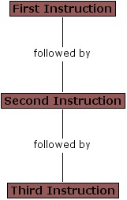
Basic Operations: Sequence

Slide 5
Basic Operations: Selection
selection occurs when the program has a choice of statements to execute
using an “if” or a “switch” statement the program determines which statement to execute afterwards
basically all decisions in programs are made this way

Slide 6
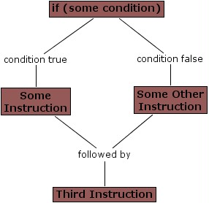
Basic Operations: Selection

Slide 7
Basic Operations: Repetition
repetition allows a program to perform some statements over and over again
using a “for” or a “while” statement is the most common way to do this
use “for” when you can calculate how many times to repeat
use “while” when you need to repeat until some condition is met

Slide 8
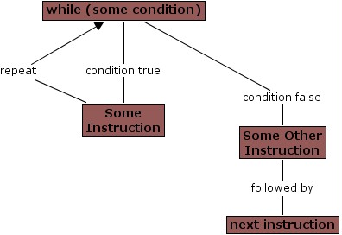
Basic Operations: Repetition

Slide 9
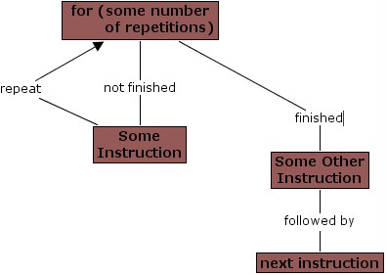
Basic Operations: Repetition

